Slide 1
Unit - vi
6.2 Basic Macro-economic concepts

Slide 2
Concept of GDP & national income
Gross Domestic product (GDP)
Gross National Product (GNP)

Slide 3
Gross Domestic Product
GDP or gross domestic product is the market value of all final goods and services produced in a country in a given time period.
This definition has four parts:
Market value
Final goods and services
Produced within a country
In a given time period

Slide 4
Gross Domestic Product
Market value
GDP is a market value - goods and services are valued at their market prices.
To add apples and oranges, computers and popcorn, we add the market values so we have a total value of output in rupees.

Slide 5
Gross Domestic Product
Final goods and services
GDP is the value of the final goods and services produced.
A final good (or service) is an item bought by its final user during a specified time period.
A final good contrasts with an intermediate good, which is an item that is produced by one firm, bought by another firm, and used as a component of a final good or service.
Excluding intermediate goods and services avoids double counting.

Slide 6
Gross Domestic Product
Produced within a country
GDP measures production within a country - domestic production.
In a given time period
GDP measures production during a specific time period, normally a year or a quarter of a year.

Slide 7
Calculating GDP
Calculating GDP requires adding together million of goods and services.
All goods and services produced by an economy must be weighted.
Each good and service is multiplied by its price.

Slide 8
growth rate
GDP in current year – GDP in previous year
--------------------------------------------------------------- x 100
GDP in previous year

Slide 9
Gross National Product/income
GDP (Domestic income) is output produced within the domestic territory.
GNP (National income) is output produced by normal resident’s of the country.
Net foreign factor income is added to GDP to move from GDP to GNP.
Net foreign factor income is the income from foreign domestic factor sources minus foreign factor incomes earned domestically.

Slide 10
Review questions
Does any of Amazon’s services count as part of GDP?

Slide 11
answer
Amazon’s business is to provide a marketplace for exchange. In doing so, it uses labor and capital and creates value. In return for creating this value, Amazon charges fees to the sellers that use its site. The value of these fees do enter into GDP.

Slide 12
Business / trade cycle
Three important economic measures relate to these alternating periods of growth and decline are :
GDP
Inflation rate
Unemployment rate

Slide 13
Business cycles
A wave like fluctuations in economic activities characterized by recurring phases of expansion and contraction
The economy of a nation moves in a cycle. Sometimes the economy grows and other times the economy shrinks.

Slide 14
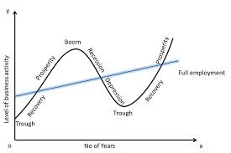
THE BUSINESS CYCLE

Slide 15
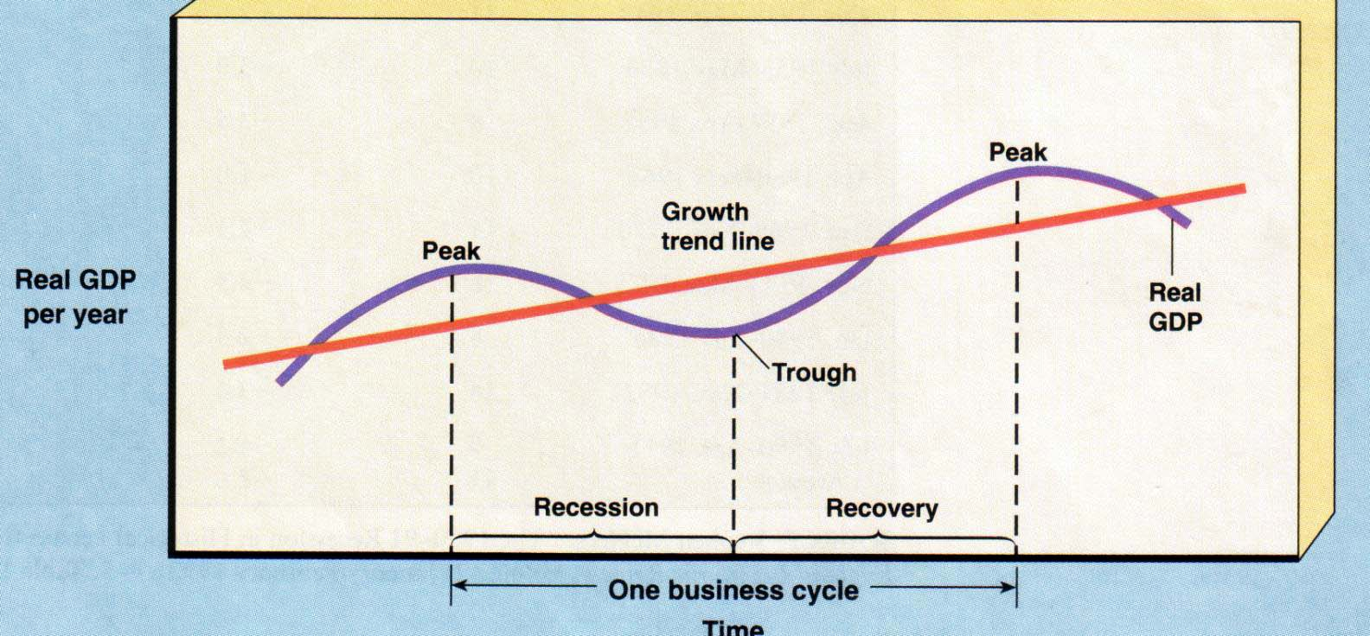
THE BUSINESS CYCLE
Inflation
Unemployment
Full employment
A recession is 6 month period of decline in output, income, employment, and trade. (If really bad…then depression)

Slide 16
four phases of the business cycle:
Expansion / Prosperity ‐ Real GDP (production) growing and unemployment rate usually falls.
Peaks / Boom ‐ Highest point of expansion. Economists can only measure once contraction begins.
Recession ‐ Real GDP (production) decreases for 6 consecutive months; unemployment rate usually increases. An extended recession is called a depression.
Troughs ‐ Lowest point of the recession. Economists can only measure once expansion / recovery / revival begins.

Slide 17
Review question
All of the following are parts of the business cycle except __________
Boom
Trough
Recession
Acceleration

Slide 18
Inflation - meaning
Inflation is the continuous rise in general price level after full employment level of output.
According to Crowther “Inflation is a state in which the value of money is falling, i. e. prices are rising.”

Slide 19
Inflation rate
Shows how much prices have increased over the last 12 months
Inflation rate = Current year’s index - Last year’s index / Last year’s index X 100

Slide 20
Example - cpi
Items | 2010 |  |  | 2011
 | P | Q | Cost | P | Q | Cost
Food | 1 | 10 | 5 | 2 | 10 | 20
Clothing | 8 | 5 | 40 | 10 | 5 | 50
 |  |  | Rs. 50 |  |  | Rs. 70

Slide 21
inflation rate
Inflation rate = Current year’s index - Last year’s index / Last year’s index x 100
70-50/50 x 100
20/50 x 100
40 %
140 – 100/100 x 100
40 %

Slide 22
Unemployment
Population = Labour force + Not in labour force
Labour force = Employed (workforce) + Unemployed
Unemployment rate = Unemployed / Labour force x 100
Labour force participation rate = Labour force / Population x 100

Slide 23
example
Year | Pop. | Not in Labour force | Employed | Unemployed | Total Labour force | Unempt. rate
2002 | 1800 | 800 | 900 | 100 | 1000 | 10%
2003 | 1800 | 820 | 900 | 80 | 980 | 8.2%

Slide 24
Review question
 | 1993-94 (mn) | 1999-00 (mn) | 2004-05 (mn)
Labour force | 381.94 | 406.05 | 469.06
Workforce | 374.45 | 397.00 | 457.82
No. of unemployed | 7.49 | 9.05 | 11.24
Unempt. Rate (%)

Slide 25
answer
 | 1993-94 | 1999-00 | 2004-05
Unempt. Rate (%) | 1.96 | 2.23 | 2.39

Slide 26
Monetary policy
Monetary policy is the management of money supply and interest rates by central banks to influence prices and employment.
Monetary policy works through expansion or contraction of investment and consumption expenditure.

Slide 27
What are the objectives of the Monetary Policy?
The objectives are to maintain price stability and ensure adequate flow of credit to the productive sectors of the economy.
Stability for the national currency (after looking at prevailing economic conditions), growth in employment and income are also looked into.

Slide 28
instruments of monetary policy/credit control
Bank Rate of Interest
Cash Reserve Ratio
Statutory Liquidity Ratio
Repo & Reverse Repo rate

Slide 29
Bank Rate of Interest
It is the interest rate which is fixed by the RBI to control the lending capacity of Commercial banks .
During inflation, RBI increases the bank rate of interest due to which borrowing power of commercial banks reduces which thereby reduces the supply of money or credit in the economy.
When money supply reduces it reduces the purchasing power and thereby curtailing consumption and lowering prices.

Slide 30
Cash Reserve Ratio
CRR, or cash reserve ratio, refers to a portion of deposits (as cash) which banks have to keep/maintain with the RBI.
During Inflation RBI increases the CRR due to which commercial banks have to keep a greater portion of their deposits with the RBI .
This serves two purposes. It ensures that a portion of bank deposits is totally risk-free and secondly it enables that RBI control liquidity in the system, and thereby, inflation.

Slide 31
Statutory Liquidity Ratio
Banks are required to invest a portion of their deposits in government securities, gold as a part of their statutory liquidity ratio (SLR) requirements .
If SLR increases the lending capacity of commercial banks decreases thereby regulating the supply of money in the economy.

Slide 32
Repo Rate
The rate at which the RBI lends money to commercial banks is called repo rate. It is an instrument of monetary policy. Whenever banks have any shortage of funds they can borrow from the RBI.
A reduction in the repo rate helps banks get money at a cheaper rate and vice

Slide 33
Reverse Repo Rate
Reverse Repo rate is the rate at which the RBI borrows money from commercial banks.
Banks are always happy to lend money to the RBI since their money are in safe hands with a good interest.
It is also a tool which can be used by the RBI to drain excess money out of the banking system.

Slide 34
Monetary Policy Statements 2017-18
Month | Details
Feb 9, 2018 | Sixth Bi-Monthly policy statement for the year 2017-18
Dec 6, 2017 | Fifth Bi-Monthly policy statement for the year 2017-18
Oct 4, 2017 | Fourth Bi-Monthly policy statement for the year 2017-18
Aug 2, 2017 | Third Bi-Monthly policy statement for the year 2017-18
Jun 7, 2017 | Second Bi-Monthly policy statement for the year 2017-18
Apr 6, 2017 | First Bi-Monthly policy statement for the year 2017-18

Slide 35
Current rates announced in sixth bi-Monthly policy statement 2017-18
Policy rates (%) -
Bank rate – 6.25
Repo rate – 6.00
Reverse repo rate – 5.75
Marginal standing facility rate – 6.25
Reserve ratio (%) -
Cash Reserve Ratio - 4
Statutory Liquidity Ratio – 19.50
Lending/Deposit rates (%) -
Base rate - 8.65 - 9.45
Savings deposit rate – 3.50 - 4.00
MCLR - 7.70 - 7.95%
Term (Fixed) deposit rate (> I year) – 6.25 -6.75

Slide 36
Fiscal Policy
It refers to the revenue and expenditure policy of the Govt. which is generally used to cure recession and maintain economic stability in the country.

Slide 37
How is the Monetary Policy different from the Fiscal Policy?
The Monetary Policy is different from Fiscal Policy as the former brings about a change in the economy by changing money supply and interest rate, whereas fiscal policy is a broader tool with the government.
The Fiscal Policy can be used to overcome recession and control inflation. It may be defined as a deliberate change in government revenue and expenditure to influence the level of national output and prices.

Slide 38
Instruments of Fiscal Policy
Public revenue - Public revenue includes that income which is not subject to repayment by the government.
Public expenditure
Public borrowing

